Slide 1

Aborted innovations:
Interlexical liquids in Capiznon
Ruchie Mark D. Pototanon
University of the Philippines Visayas
Philip Rentillo
De La Salle University
Linguistic Society of the Philippines International Conference (LSPIC)
De La Salle University
Manila, Philippines
March 7-9, 2019
* See slide notes for page directions
Notes:
When listing all project collaborators, either use commas or bullets

Slide 2
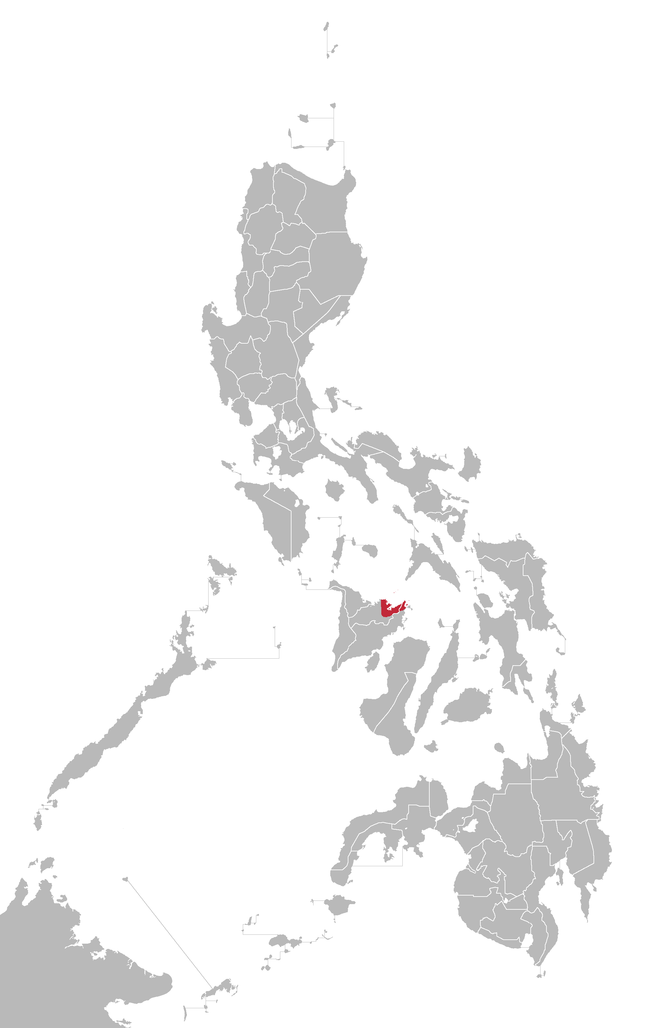
What is Capiznon?
Notes:
Insert a map of your colony (draw it, ink it, or create it in PPT- be creative!)
Insert -> Pictures for photos
Draw for digital inking
Insert -> Shapes if you want to create it in PPT
All mountains, towns/villages, bodies of water/waterways, landmarks, etc. should be clearly labeled

Slide 3
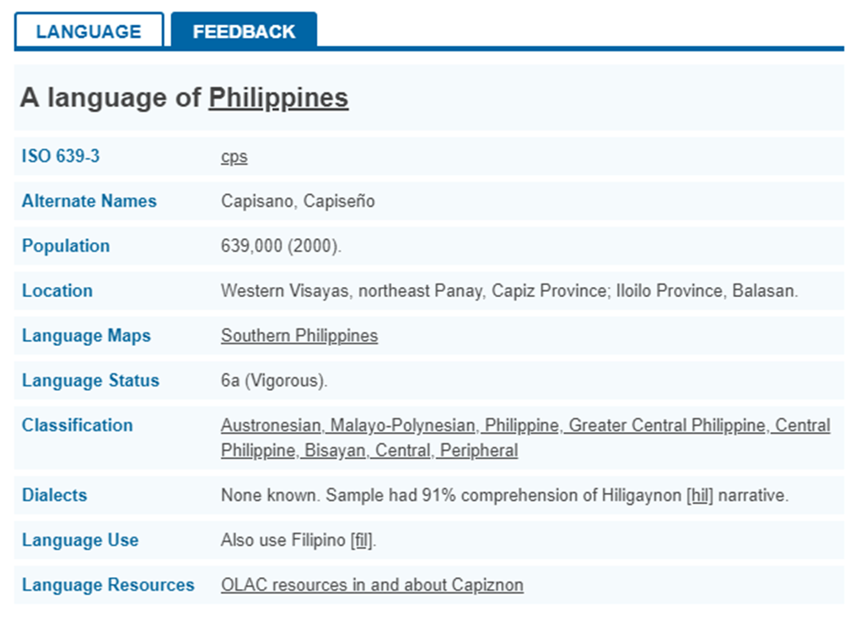
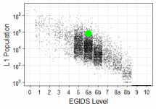
What is Capiznon?
Notes:
What is the name of your colony song?
Write lyrics to the song and, if you are feeling creative, use a computer program or instruments to create the music that goes along with it!
To insert an audio file, click on Recording -> Audio -> Audio on My PC and choose your file

Slide 4
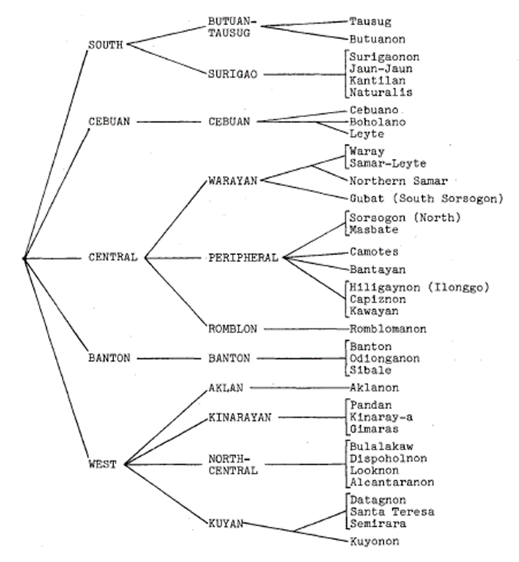
A language or dialect?
Classification of Visayan languages (Zorc, 1977)
Notes:
What is the name of your colony song?
Write lyrics to the song and, if you are feeling creative, use a computer program or instruments to create the music that goes along with it!
To insert an audio file, click on Recording -> Audio -> Audio on My PC and choose your file

Slide 5
The current study
Objectives
This study aims to:
Review the existing literature on liquids and related consonants in Philippine languages with focus on Visayan languages which Capiznon purportedly belongs;
Characterize the conditions which elicit this unique reflex;
Notes:
What is the name of your colony song?
Write lyrics to the song and, if you are feeling creative, use a computer program or instruments to create the music that goes along with it!
To insert an audio file, click on Recording -> Audio -> Audio on My PC and choose your file

Slide 6
The current study
Objectives
This study aims to:
Reanalyze the phenomenon in the context of the phonological systems of Capiznon and related (and close) languages; and
Assess the persistence of the phenomenon and how it can contribute to the characterization of Capiznon as a language.
Notes:
What is the name of your colony song?
Write lyrics to the song and, if you are feeling creative, use a computer program or instruments to create the music that goes along with it!
To insert an audio file, click on Recording -> Audio -> Audio on My PC and choose your file

Slide 7
The current study
Limitations
No actual voice recordings were involved in the analysis
Actual notation in original literature where Capiznon was attested is used
Notes:
What is the name of your colony song?
Write lyrics to the song and, if you are feeling creative, use a computer program or instruments to create the music that goes along with it!
To insert an audio file, click on Recording -> Audio -> Audio on My PC and choose your file

Slide 8
Discussion
Liquids in
Philippine languages

Slide 9
Liquids in Philippine languages
Conant (1916)
Three (3) liquids in Philippine languages
  /l/ from the RLD series
  /l/ from the RGH series
  The “Indonesian” *l
Notes:
What is the name of your colony song?
Write lyrics to the song and, if you are feeling creative, use a computer program or instruments to create the music that goes along with it!
To insert an audio file, click on Recording -> Audio -> Audio on My PC and choose your file

Slide 10
Liquids in Philippine languages
Conant (1916)
Loss of intervocalic /l/ (VlV)
  “Cockneyism” in Cebuano
    Elision
      balaj > baaj (‘house’)
    Epenthesis
      kanɁon > kalanɁon (‘foodstuff’)
  In Tausug
    pilih > pii (‘choose’)
  In Tagalog
    balaj > bahaj (‘house’)
    bulan > buwan (‘moon, month’)
Notes:
What is the name of your colony song?
Write lyrics to the song and, if you are feeling creative, use a computer program or instruments to create the music that goes along with it!
To insert an audio file, click on Recording -> Audio -> Audio on My PC and choose your file

Slide 11
Liquids in Philippine languages
Verstraelen (1960)
r > l in loans from Sanskrit to Tagalog
  antara > antala (‘delay, interval’)
Tagalog *l reflex
  VlV > ø > h/Ɂ
    dalan > daɁan (‘road, path’)
  olV > owV
    bulan > buwan (‘moon, month’)
  ilV > ujV
    hilak > ijak (‘cry’)
Notes:
What is the name of your colony song?
Write lyrics to the song and, if you are feeling creative, use a computer program or instruments to create the music that goes along with it!
To insert an audio file, click on Recording -> Audio -> Audio on My PC and choose your file

Slide 12
Liquids in Philippine languages
Verstraelen (1960)
Notes:
What is the name of your colony song?
Write lyrics to the song and, if you are feeling creative, use a computer program or instruments to create the music that goes along with it!
To insert an audio file, click on Recording -> Audio -> Audio on My PC and choose your file

Slide 13
Liquids in Philippine languages
Verstraelen (1960)
Colloquial Cebuano
  Reflexes
    -ala- > -a:-
    -ili- > -i:-
    -olo- > -o:-
    -alo- > -ao-
    -ola- > -uwa-
  Exceptions
    Foreign, loaned words
    -ali-, -ila-, -uli-, -ilu-
Notes:
What is the name of your colony song?
Write lyrics to the song and, if you are feeling creative, use a computer program or instruments to create the music that goes along with it!
To insert an audio file, click on Recording -> Audio -> Audio on My PC and choose your file

Slide 14
Liquids in Philippine languages
Zorc (1977)
Synchronic phonology
  BIS /l/ > BAN, ODG, SIB /y/, AKL [ł]
    BIS qulu (‘head’) > BAN, ODG, SIB quyu; AKL qułu
    But not in -il- or -li-
      BIS kilala (‘recognize’) > BAN, ODG, SIB kilaya; AKL kilała
  /l/~/d/, /-r-/~/d/
    nawalaq > nawadqan (‘lost, missing’)
Notes:
What is the name of your colony song?
Write lyrics to the song and, if you are feeling creative, use a computer program or instruments to create the music that goes along with it!
To insert an audio file, click on Recording -> Audio -> Audio on My PC and choose your file

Slide 15
Liquids in Philippine languages
Zorc (1977)
Phonology of proto-Bisayan
*d-, *-d, *dC > /d/ except for the Banton Group
*VdV > /VrV/ or /VlV/
*r cannot be reconstructed
Notes:
What is the name of your colony song?
Write lyrics to the song and, if you are feeling creative, use a computer program or instruments to create the music that goes along with it!
To insert an audio file, click on Recording -> Audio -> Audio on My PC and choose your file

Slide 16
Discussion
Aborted innovations in Capiznon

Slide 17
Aborted innovations in Capiznon
Ubal (1970)
Master’s thesis
  Dialectological survey of six (6) towns in Capiz (Ivisan, Sigma, Panitan, Dumarao, President Roxas & Tapaz)
  100-item wordlist
  Age stratification as a variable
    65 years old onwards
    30-45 years old
    14-25 years old
Notes:
What is the name of your colony song?
Write lyrics to the song and, if you are feeling creative, use a computer program or instruments to create the music that goes along with it!
To insert an audio file, click on Recording -> Audio -> Audio on My PC and choose your file

Slide 18
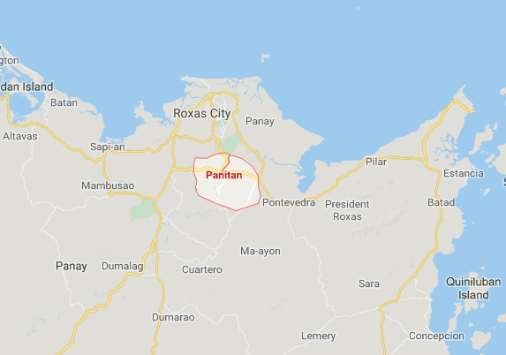
Aborted innovations in Capiznon
Ubal (1970)
“Peculiar phonology” attested in Panitan where /l/ is changed to /y/ or /w/
Notes:
What is the name of your colony song?
Write lyrics to the song and, if you are feeling creative, use a computer program or instruments to create the music that goes along with it!
To insert an audio file, click on Recording -> Audio -> Audio on My PC and choose your file

Slide 19
Aborted innovations in Capiznon
Ubal (1970)
“Peculiar phonology” attested in Panitan where /l/ is changed to /y/ or /w/
Age group | Panitan | Rest of surveyed areas | Gloss
a, b, c | bugawin | bugalon | boastful
a | suwig/agak | sulog | cock
a | matig-at uwi | matig-a sang ulo | dull
a, b | maaym | maalam | intelligent
a | daygan | dalagan | run
a, b, c | dawik | dalok | selfish
 | baeI | balaI | house
 | dayga | dalaga | young woman
 | ulu | uwi | head
 | maguwayng | magulang | elder
Notes:
What is the name of your colony song?
Write lyrics to the song and, if you are feeling creative, use a computer program or instruments to create the music that goes along with it!
To insert an audio file, click on Recording -> Audio -> Audio on My PC and choose your file

Slide 20
Aborted innovations in Capiznon
Uy-Griño (2011)
Republished paper based on a fieldwork conducted from 1971 to 1974
  The dialects of Panay and the implications of the manner of their spread (3rd ed.)
  Identified dialectal areas across known Kinaray-a, Aklanon and Hiligaynon speaking communities
Notes:
What is the name of your colony song?
Write lyrics to the song and, if you are feeling creative, use a computer program or instruments to create the music that goes along with it!
To insert an audio file, click on Recording -> Audio -> Audio on My PC and choose your file

Slide 21
Aborted innovations in Capiznon
Uy-Griño (2011)
Using AKL, KRJ and HIL as base lects
  Lects that have [r] for [l] or [ł] and the unrounded back vowel [ɯ] are considered “deep” Kinaray-a
  Lects with the velar fricative[ł] for [r] and [l] are considered “deep” Aklanon
  Lects with [l] for [r] and [l] are considered “deep” Hiligaynon
  Any departure from any pattern is evidence of a subtype
Notes:
What is the name of your colony song?
Write lyrics to the song and, if you are feeling creative, use a computer program or instruments to create the music that goes along with it!
To insert an audio file, click on Recording -> Audio -> Audio on My PC and choose your file

Slide 22
Aborted innovations in Capiznon
Uy-Griño (2011)
Capiznon as a subdialect of Hiligaynon
  More [l] than [r], til’as vs iras (‘bristly caterpillar’)
  Uses [r] instead of [d], iro vs ido (‘dog’)
  54 unique lexical items such as yanda vs HIL subong (‘now, today’)
Notes:
What is the name of your colony song?
Write lyrics to the song and, if you are feeling creative, use a computer program or instruments to create the music that goes along with it!
To insert an audio file, click on Recording -> Audio -> Audio on My PC and choose your file

Slide 23
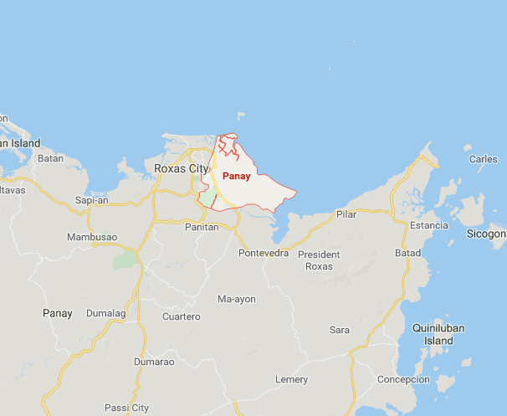
Aborted innovations in Capiznon
Uy-Griño (2011)
Reflexing of /l/ into higher sonority in Pan-aynon spoken along the Pan-ay River Delta
Notes:
What is the name of your colony song?
Write lyrics to the song and, if you are feeling creative, use a computer program or instruments to create the music that goes along with it!
To insert an audio file, click on Recording -> Audio -> Audio on My PC and choose your file

Slide 24
Aborted innovations in Capiznon
Uy-Griño (2011)
Reflexing of /l/ into phoneme with higher sonority attested in Pan-ay
  /ula/ > /uwæ/, /alu/ > /awū/
    kulapdap > kuwæpdap (‘white edible fungus)
    pula > puwæ (‘red’)
    talum > tawūm (‘blade’)
  /ulu/, /ala/ > V2 elision + vowel lengthening
    balagbag > bæ:bag (‘bamboo slats’)
    madulum > madūm (‘dark’)
  /l/ becomes /j/
    bungol > bungoj (‘deaf)
Notes:
What is the name of your colony song?
Write lyrics to the song and, if you are feeling creative, use a computer program or instruments to create the music that goes along with it!
To insert an audio file, click on Recording -> Audio -> Audio on My PC and choose your file

Slide 25
Aborted innovations in Capiznon
Uy-Griño (2011)
Reflexing of /l/ into phoneme with higher sonority attested in Pan-ay
  *-la-
    ulan > uwajn (‘rain’)
    hulat > huwajt (‘to wait’)
    bulaŋ > buwajŋ (‘cockfight’)
    dalawat > dajwat (‘to buy rice’)
    naglalakat > naglajkat (‘walk’)
  *-lu-
    tulug > tuwig (‘sleep’)
    talun > tawin (‘forest’)
    puluɁ > puwiɁ (‘ten’)
  *-l
    dungul > dunguj (‘stubborn’)
    bakal > bakaj (‘buy, purchase’)
Notes:
What is the name of your colony song?
Write lyrics to the song and, if you are feeling creative, use a computer program or instruments to create the music that goes along with it!
To insert an audio file, click on Recording -> Audio -> Audio on My PC and choose your file

Slide 26
Aborted innovations in Capiznon
Uy-Griño (2011)
Reflexing of /l/ into phoneme with higher sonority attested in Pan-ay
  Phonological conditions
    Fusion of proto-BIS *-d- and *l
      PMP *quzan > PPh *udan > BIS ulan > CPS uwajn (‘rain’)
      PAn *bulaN > PPh *bulan > BIS bulan > CPS buwajn (‘moon, month’)
    Does not occur if after /i/
      pilaɁ (‘to spit’) but no *piwajɁ
    Does not occur if before semivowels
      bulaw (‘to oversleep’) but no *buwajw
Notes:
What is the name of your colony song?
Write lyrics to the song and, if you are feeling creative, use a computer program or instruments to create the music that goes along with it!
To insert an audio file, click on Recording -> Audio -> Audio on My PC and choose your file

Slide 27
Conclusion
Final (and initial) thoughts

Slide 28
Conclusion
Final (and initial) thoughts
Data collected more than 40 years ago and Ubal (1970) indicates that it is elicited from speakers 65 years old and older
Stigmatized due to deviation from features of Hiligaynon, the lingua franca of Western Visayas and thus Capiznons
Notes:
What is the name of your colony song?
Write lyrics to the song and, if you are feeling creative, use a computer program or instruments to create the music that goes along with it!
To insert an audio file, click on Recording -> Audio -> Audio on My PC and choose your file

Slide 29
Conclusion
Final (and initial) thoughts
Complications on orthography and phonology
  Does not conform to basic syllable structure of PH languages which is CV(C)
  Diphthongs or fronting and “reduction” of the rounding of vowels cannot be easily accommodated in the present orthography
  Allophonic to most /l/ in (Central) Visayan Languages
Notes:
What is the name of your colony song?
Write lyrics to the song and, if you are feeling creative, use a computer program or instruments to create the music that goes along with it!
To insert an audio file, click on Recording -> Audio -> Audio on My PC and choose your file

Slide 30
Conclusion
Final (and initial) thoughts
Possible feature of an angry register
This innovation might represent a consonant development across Visayan languages parallel to the likes of Cebuano, Butuanon, Surigaonon and Aklanon
Notes:
What is the name of your colony song?
Write lyrics to the song and, if you are feeling creative, use a computer program or instruments to create the music that goes along with it!
To insert an audio file, click on Recording -> Audio -> Audio on My PC and choose your file

Slide 31
References

Slide 32
References
Conant, Carlos Everett (1916) “Indonesian l in Philippine Languages” Journal of the American Oriental Society, Vol. 36 pp. 181-196.
Pototanon, Ruchie Mark D. and Michael Wilson I. Rosero “An Acoustic and Articulatory Characterization of Capiznon Segmental Sounds”. Unpublished Research Paper. University of the Philippines-Diliman.
Simons, G. F., & Fennig C. D. (eds.). (2018). Ethnologue: Languages of the World (17th ed.). Dallas: SIL International.
Ubal, Lagrimas (1970) “A survey of the dialect geography of six towns in Capiz (Ivisan, Sigma, Panitan, Dumarao, President Roxas & Tapaz)”. Master’s Thesis. Quezon City, University of the Philippines
Uy-Grino, Eliza Yap (2011) The dialects of Panay and the implications of the manner of their spread (3rd ed). Jaro, Iloilo City, Phils. : Central Phil. University.
Verstraelen, Eugene. “An Essay Towards A Historical Description of Tagalog and Cebuano Bisaya”. Philippine Studies vol. 8, no. 3 : 491—514
Zorc, David Paul (1977). The Bisayan Dialects of the Philippines: Subgrouping and Reconstruction. Canberra, Australia: Dept. of Linguistics, Research School of Pacific Studies, Australian National University.
Notes:
What is the name of your colony song?
Write lyrics to the song and, if you are feeling creative, use a computer program or instruments to create the music that goes along with it!
To insert an audio file, click on Recording -> Audio -> Audio on My PC and choose your file

Slide 33
Madamo gid tiya
nga salamat!
Aborted innovations:
Interlexical liquids in Capiznon
Notes:
Insert a map of your colony (draw it, ink it, or create it in PPT- be creative!)
Insert -> Pictures for photos
Draw for digital inking
Insert -> Shapes if you want to create it in PPT
All mountains, towns/villages, bodies of water/waterways, landmarks, etc. should be clearly labeled

