Slide 1
Visualization and interconnection:
The case of Aklanon
The 29th Meeting of the Southeast Asian Linguistics Society
Tokyo | May 27-29, 2019
Philip Rentillo
De La Salle University
philip.rentillo@dlsu.edu.ph
Louward Allen Zubiri
University of the Philippines Diliman
lamzubiri@up.edu.ph

Slide 2
Aklanon
Western Visayan language under the Central Philippine group (Zorc, 1977)
Known for its voiced velar fricative [ɣ] phoneme
Language profile (Ethnologue, 2019)
ISO 639-3 | AKL
Alternate names: | Akeanon, Aklan, Aklano, Inakeanon
Population: | 559,416 (2010, CPH)
Location: | Aklan province, north Panay island
Language Status: | 4 (Educational)

Slide 3
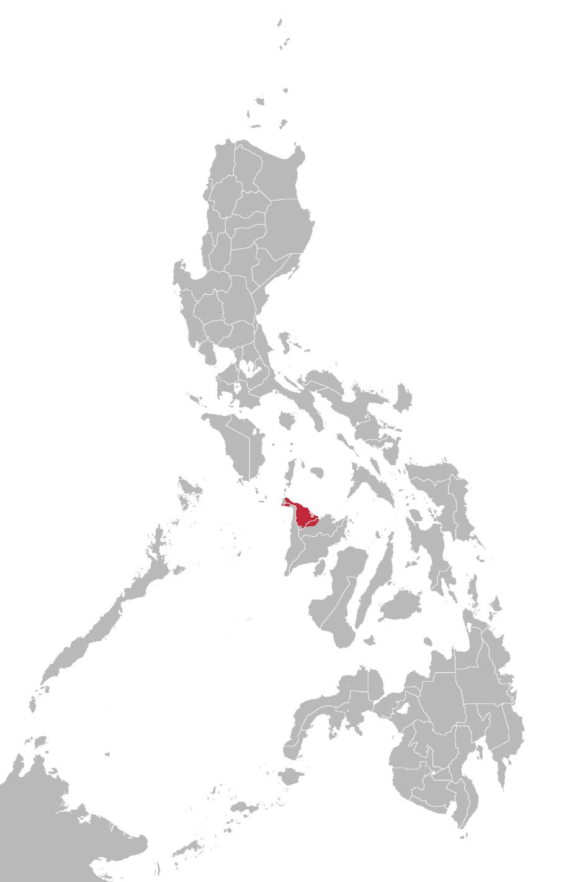
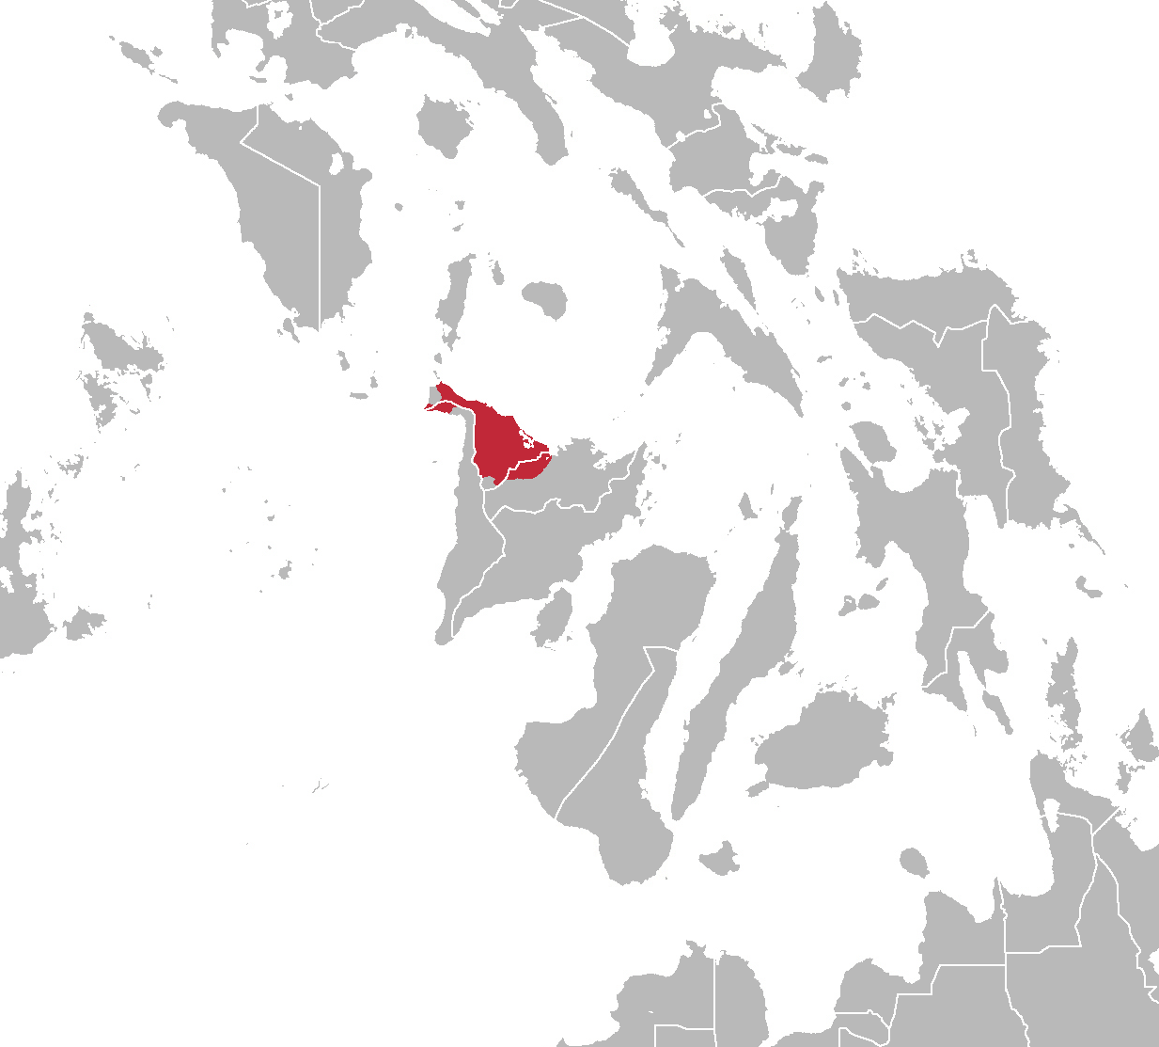

Slide 4
The Aklanon reflex
Shared Visayan cognates | Aklanon cognate | Gloss
lalaki | (ɣa)ɣaki | man; male
lupad | ɣupad | flight
bula | buɣa | bubble
walo | waɣo | eight
balaj | baɣaj | house
tulon | tuɣon | (to) swallow
bunal | bunaɣ | (to) hit with stick
habol | haboɣ | blanket; weaving
halʔo [HIL, KRJ] | haɣʔo | pestle
tulʔan | tuɣʔan | bone; joint

Slide 5
Descriptions of Aklanon
Scheerer (1920)
dela Cruz & Zorc (1968)
Salas Reyes, Zorc & Prado (1969)
Zorc (1977)
Paz (1981)
Zorc (2005)

Slide 6
Descriptions of Aklanon
Scheerer (1920, pp. 246-247)
One of the earliest if not the very first known systematic description of the Aklanon language “…einen leicht stimmhaften Gaumen-Reibelaut” (p. 249) …a slightly voiced velar (palatal) fricative ⟨ê⟩ Compared /ɣ/ distribution with Bisayan cognates based on RDL (and RGH) laws

Slide 7
Descriptions of Aklanon
dela Cruz & Zorc (1968, p. 33) | Salas Reyes, Zorc & Prado (1969, pp. 14-15; 35) | Zorc (1977, p. 23) | Paz (1981, p. 23)
Voiced velar fricative /ɣ/ Consonant & word-final semivowel ⟨g⟩ |  | Velar (spirant) /ł/ | Voiced velar fricative /ɣ/ ⟨g⟩
Zorc (2005, p. 128)
Lacks friction; unrounded back semivowel /ɤ/ as a semivowel (e.g. /hambaɤ/ in hambae) /ɣ/ as a consonant (e.g. /ɣapok/ in eapok) <e>

Slide 8
Paz’ (1981) brief description of Aklanon
Two proto-l’s compared to Llamzon’s (1975) set
Proto-L1 (*l) for all clear /l/ in modern Philippine languages affected by RLD law
Proto-L2 (*L) in limited PhLs
  Transcribed by Paz (1981) as L for Kalinga; x for Itbayat; Y for Viracnon; g for Aklanon; and y for Buhid
  Although predominantly alveolar, this set is different from the uniform alveolar *l since it might have been articulated further back in the oral cavity, hence a distinct *L

Slide 9
Related works in Philippine dialectology and geolinguistics
Few published work on dialectology of Philippine languages
  Bikol (McFarland, 1974)
  Bikol Sorsogon (Cunanan, 2015)
  Inonhan (Javier, 2012)
  Marinduque Tagalog subdialects (Pelaez-Soberano, 1977)

Slide 10
Related works in Philippine dialectology and geolinguistics
Majority unpublished theses and projects on dialect geography across select towns
  Catanduanes (Dolores, 1972)
  Capiz (Argos, 1969)
  Misamis Occidental (Mutia, 1970)
  La Union (Sabado, 1970)

Slide 11
Related works in Philippine dialectology and geolinguistics
Majority unpublished theses and projects on dialect geography across select towns
  Northern Samar (Aban, 1970)
  Negros Occidental (Jaena, 1970)
  Nueva Ecija (Ang, 1973; 1976)
  Kalinga-Apayao (Navarro, 1975)

Slide 12
The current study
Main focus
Absence of dialectological work on Aklanon
Lack of geolinguistic attention to Panay as a hotbed of linguistic diversity
Lack of thrust to integrate more contemporary methods to Philippine dialectology

Slide 13
Method
Informants
2 informants each from 17 municipalities in Aklan, 1 from a bordering municipality in Capiz and Antique, respectively; total of 36 informants
Age range of 18-65 years old
Should have lived in their represented towns for no less than ten consecutive years

Slide 14
Method
Data analysis
Lexeme-based features and isoglosses visualized through both traditional administrative borders and Voronoi polygons
Use of visualization methods
  ArcGIS to produce GIS-based lexeme maps
  SIL Cog to produce a similarity matrix, a network graph, and comparative dendrograms based on lexical and phonetic data

Slide 15
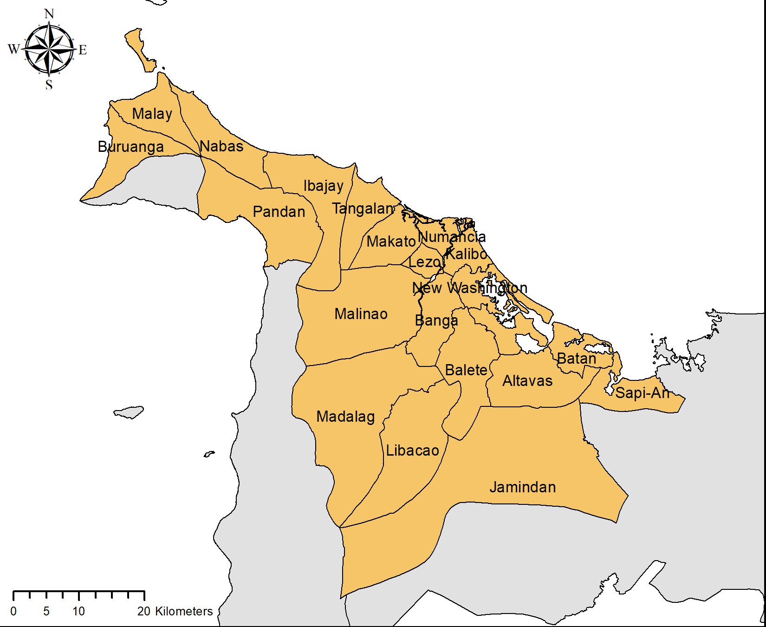

Administrative map vis-à-vis token map

Slide 16


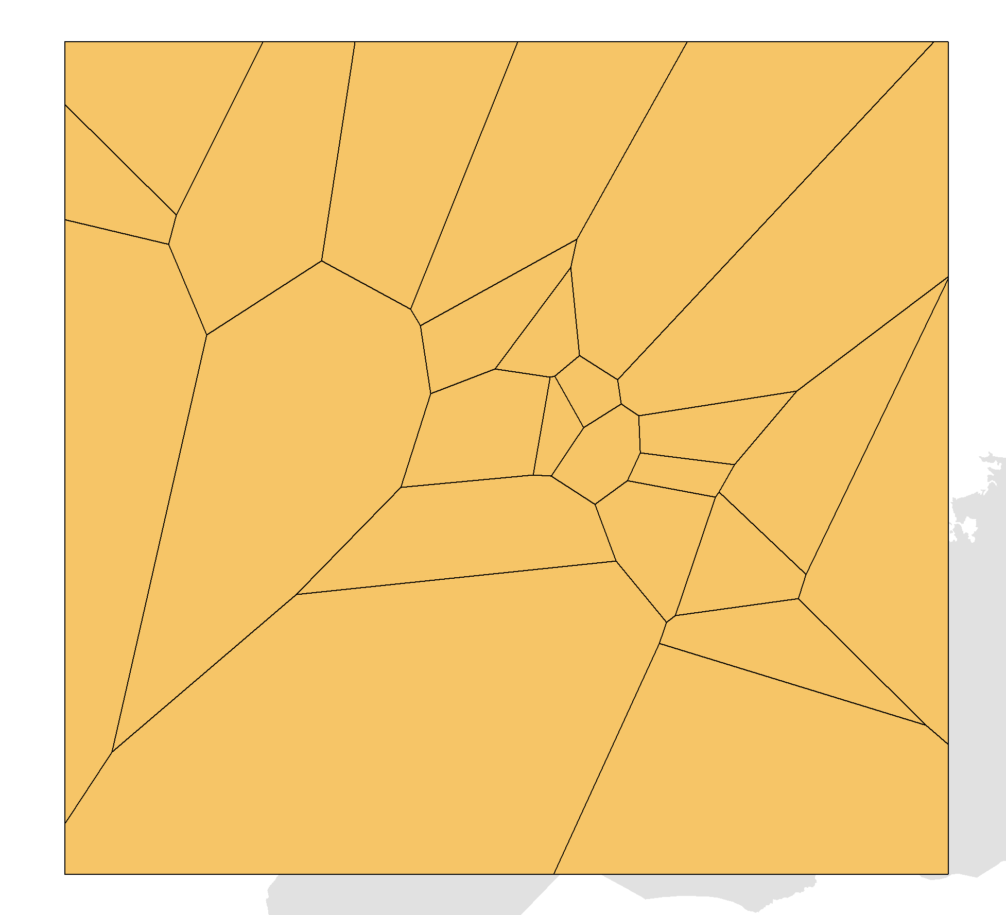
Voronoi polygons

Slide 17
Results
Lexeme maps
  Traditional, administrative division-based
  Voronoi polygon representations
Non-cartographic visualization
  Similarity matrix
  Network graph
  Comparative dendrograms (NJ & UPGM methods)

Slide 18
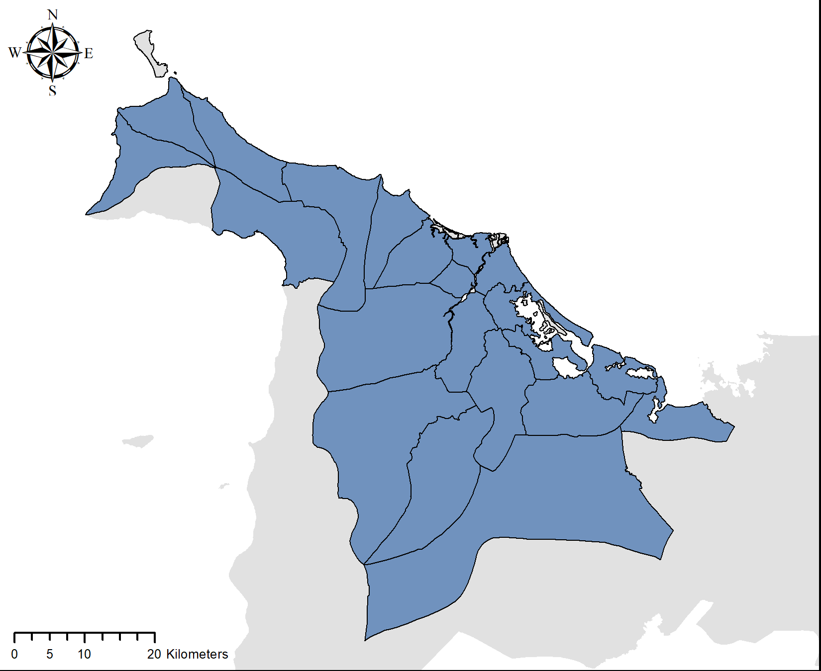
SEVEN
Traditional lexeme map
[pɪ'tɔ]

Slide 19
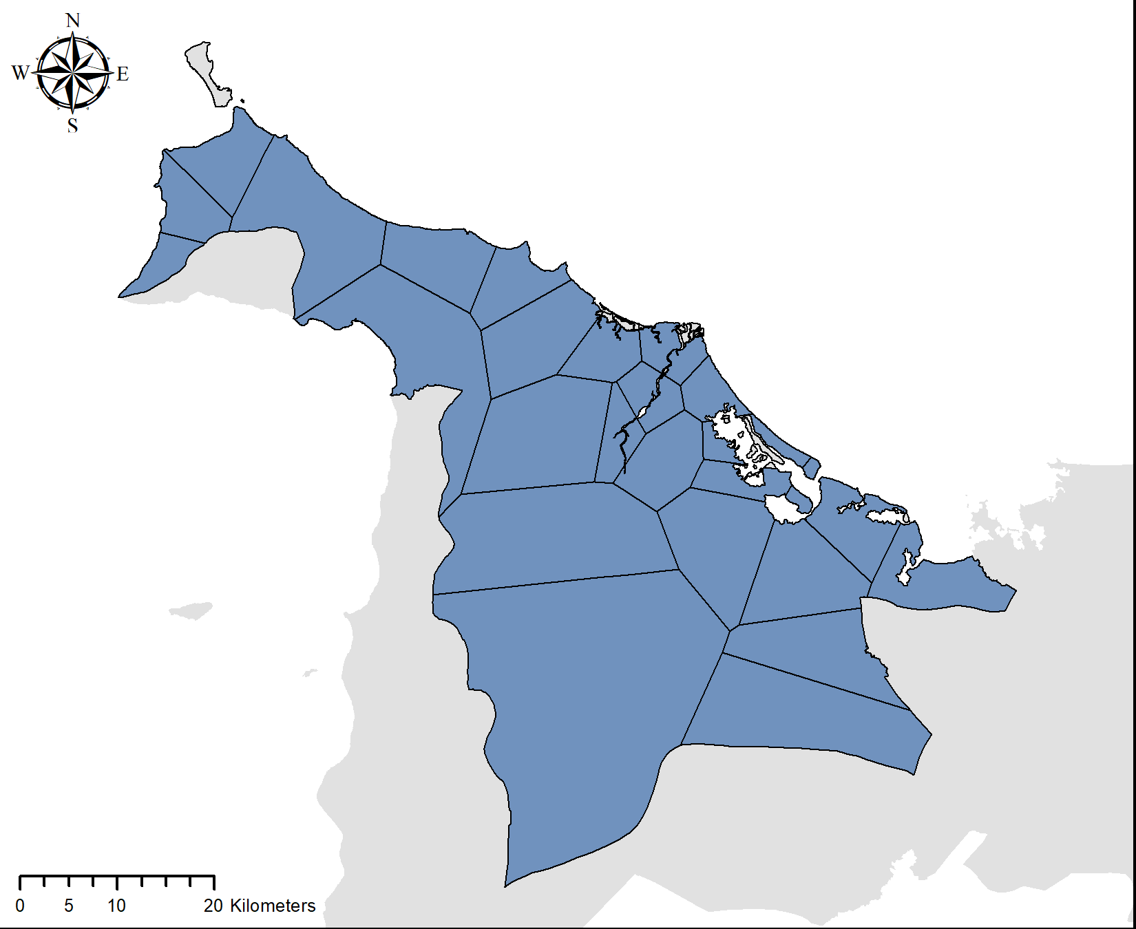
SEVEN
Lexeme map based on Voronoi method
[pɪ'tɔ]

Slide 20
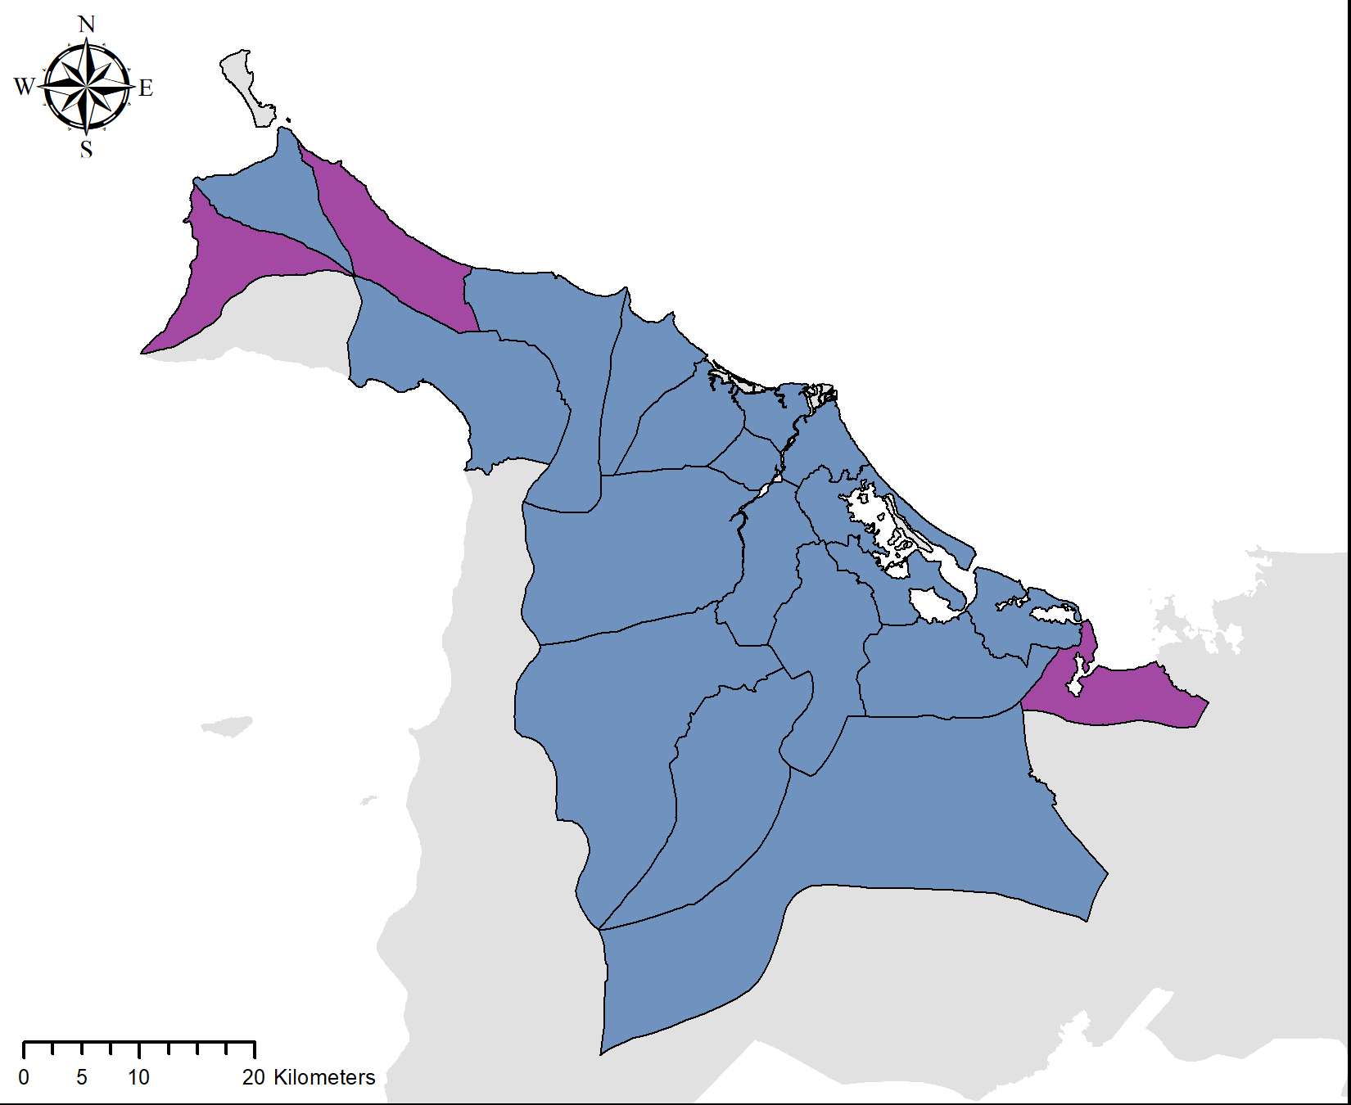
BODY (anatomical)
Traditional lexeme map
['lawas]
['ɣawas]

Slide 21

BODY (anatomical)
Lexeme map based on Voronoi method
['lawas]
['ɣawas]

Slide 22
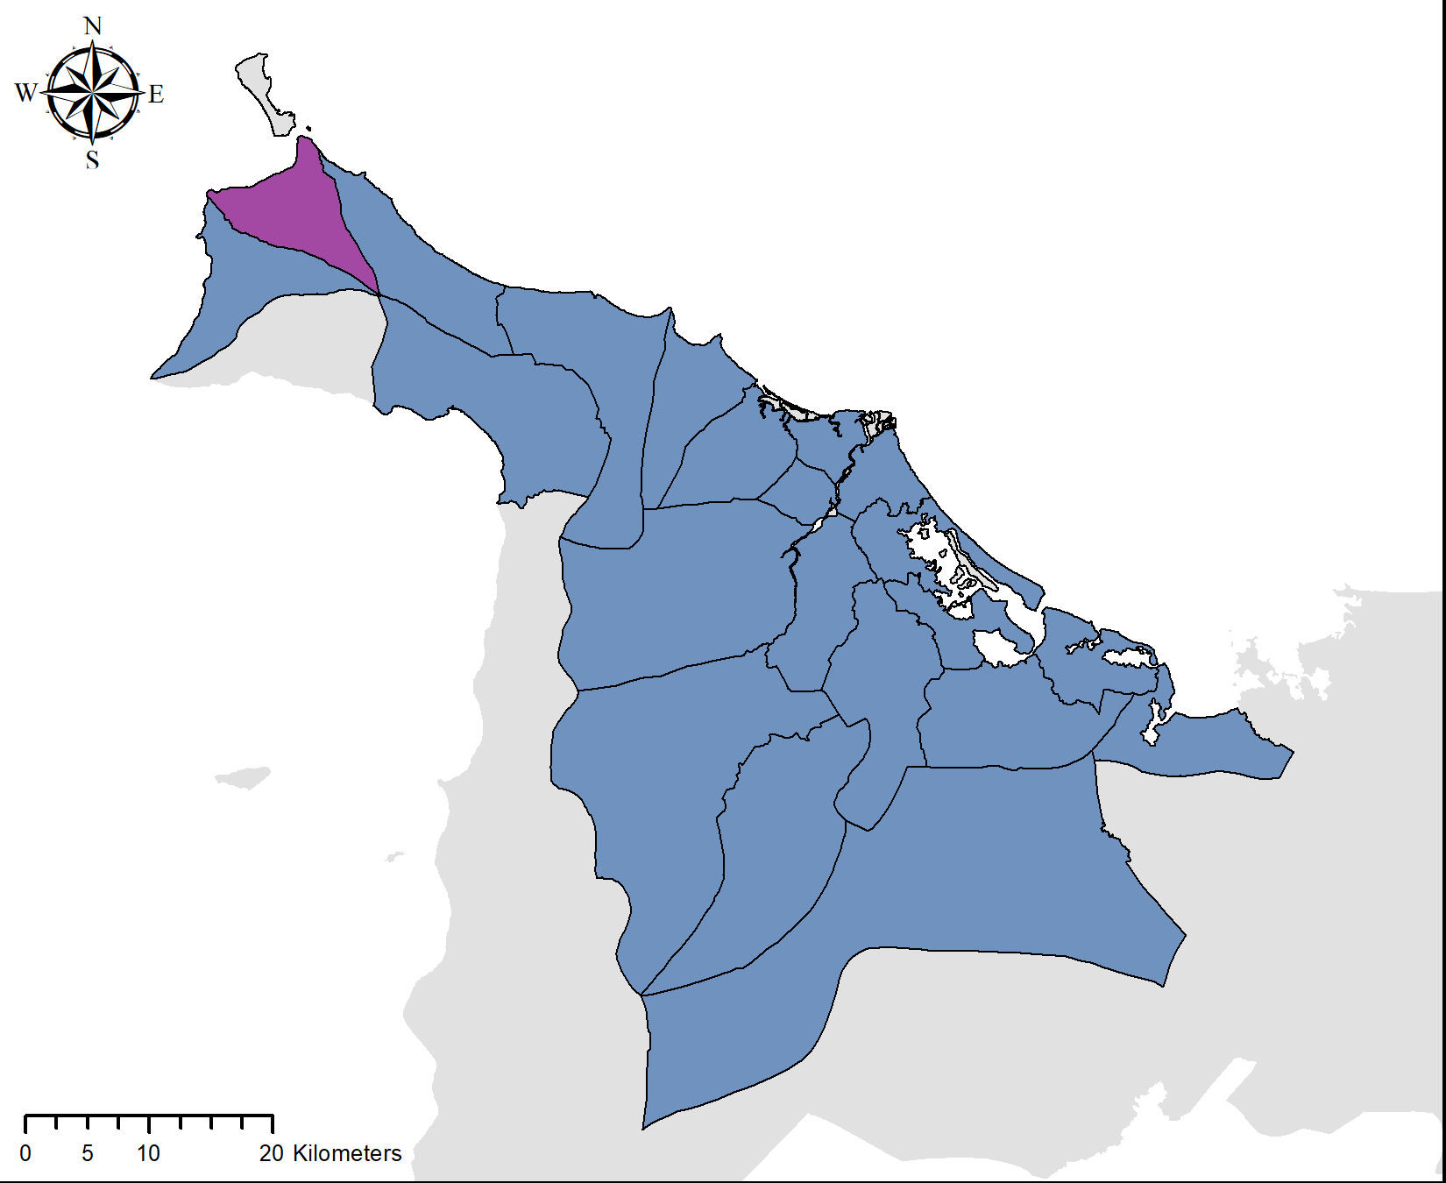
(TO) STAB
Traditional lexeme map
[bi'dʒuʔ]
[bu'nɔʔ]

Slide 23

(TO) STAB
Lexeme map based on Voronoi method
[bi'dʒɔʔ]
[bu'nɔʔ]

Slide 24
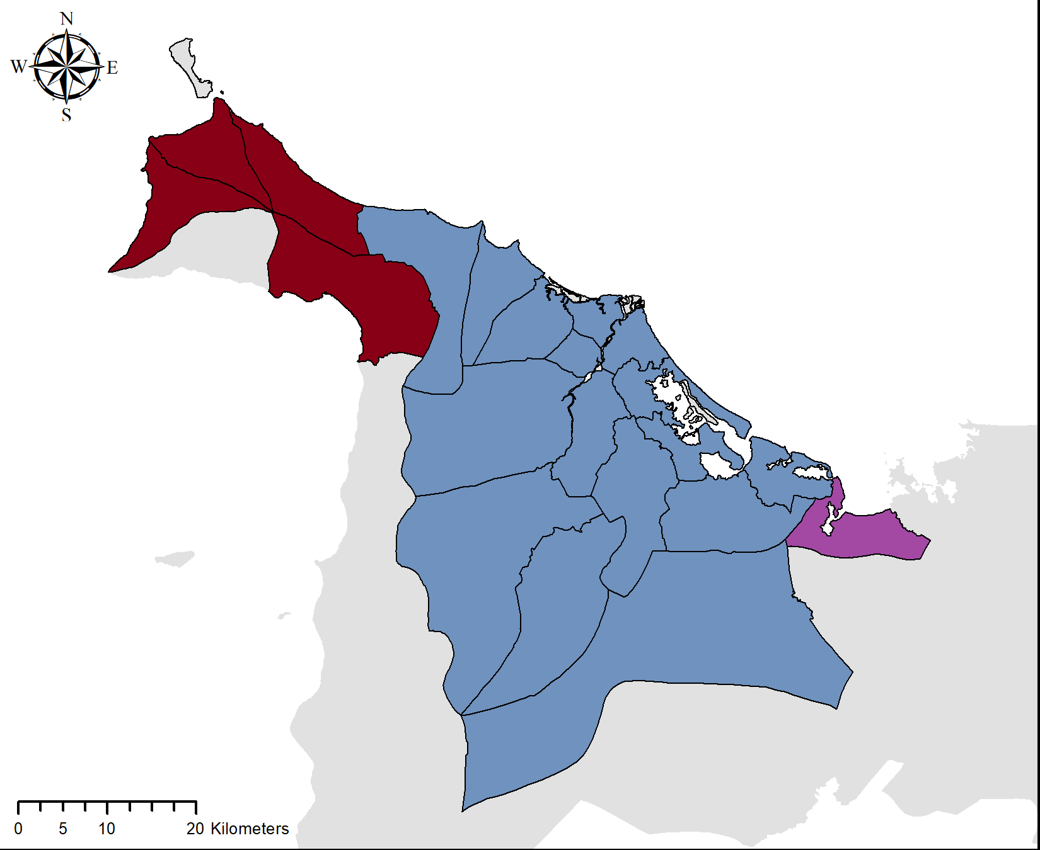
Traditional lexeme map
FENCE
[ku'dal]
[ku'raɣ]
[ku'ral]

Slide 25
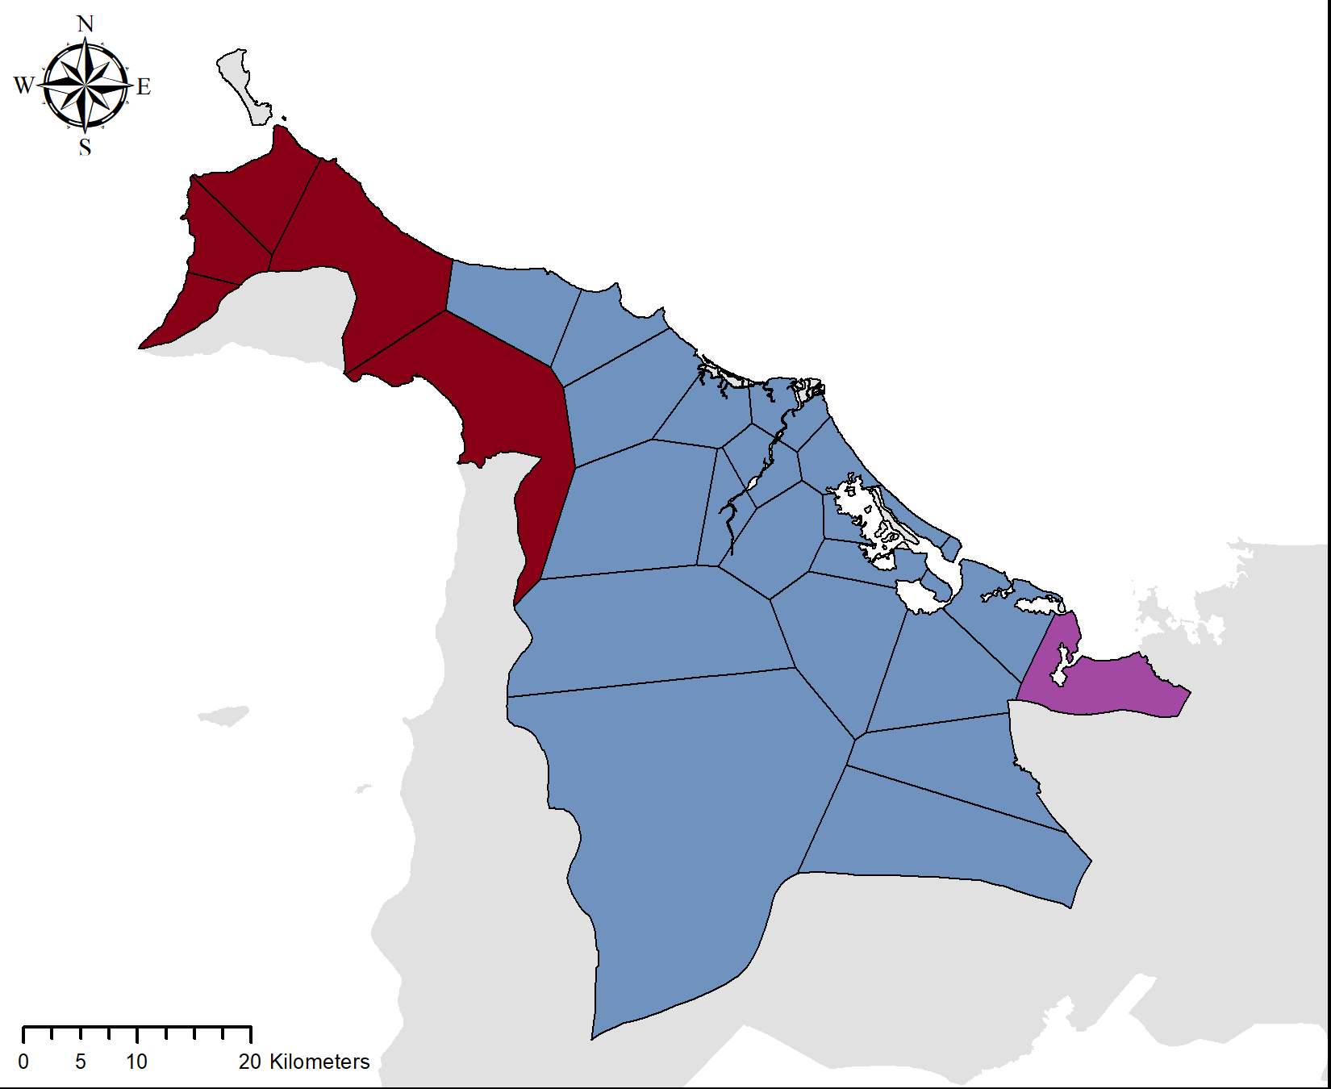
Lexeme map based on Voronoi method
FENCE
[ku'dal]
[ku'raɣ]
[ku'ral]

Slide 26
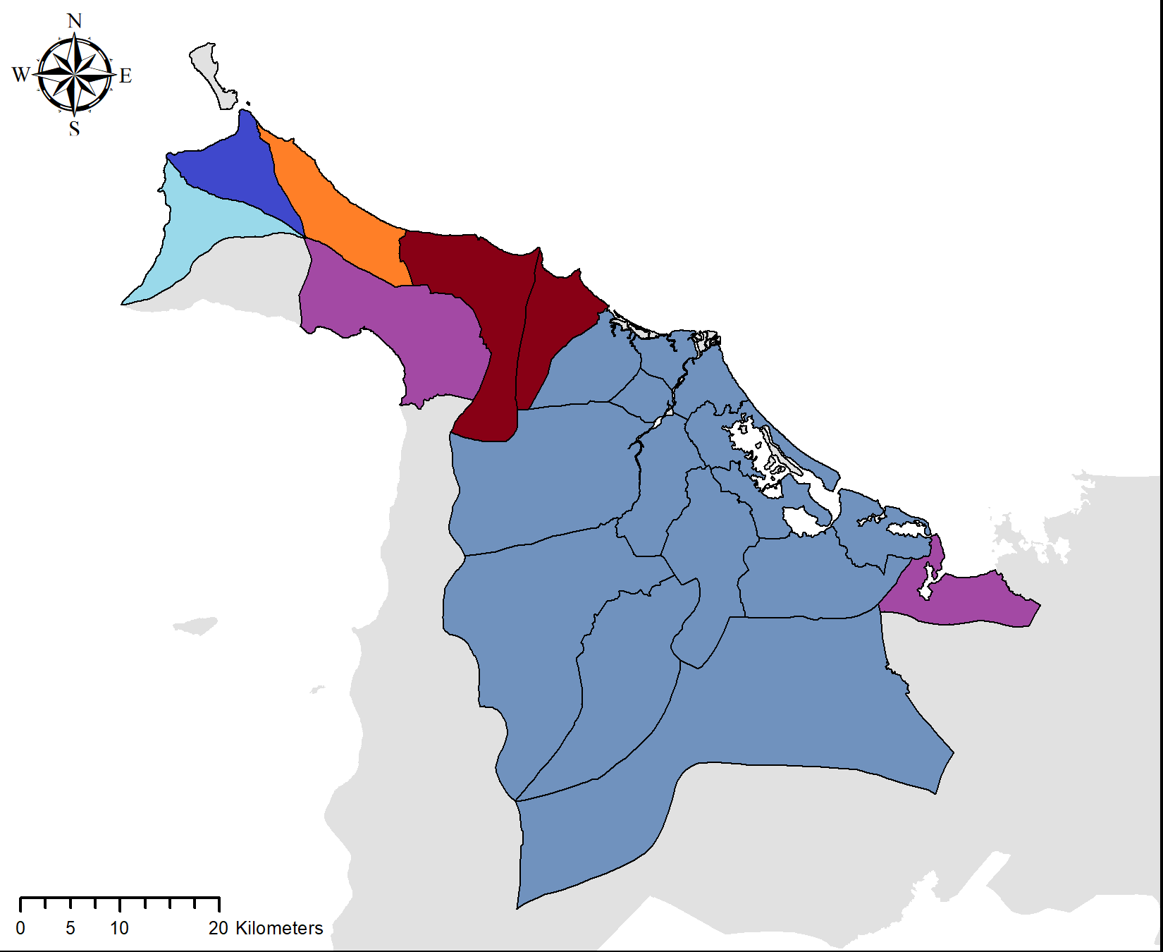
Traditional lexeme map
THUNDER
[da'ʔugdɔg]
[da'guʔɔg]
[da'guʔɔb]
[du'ɣugdɔg]
[da'ɣugdɔg]
[da'lugdɔg]

Slide 27
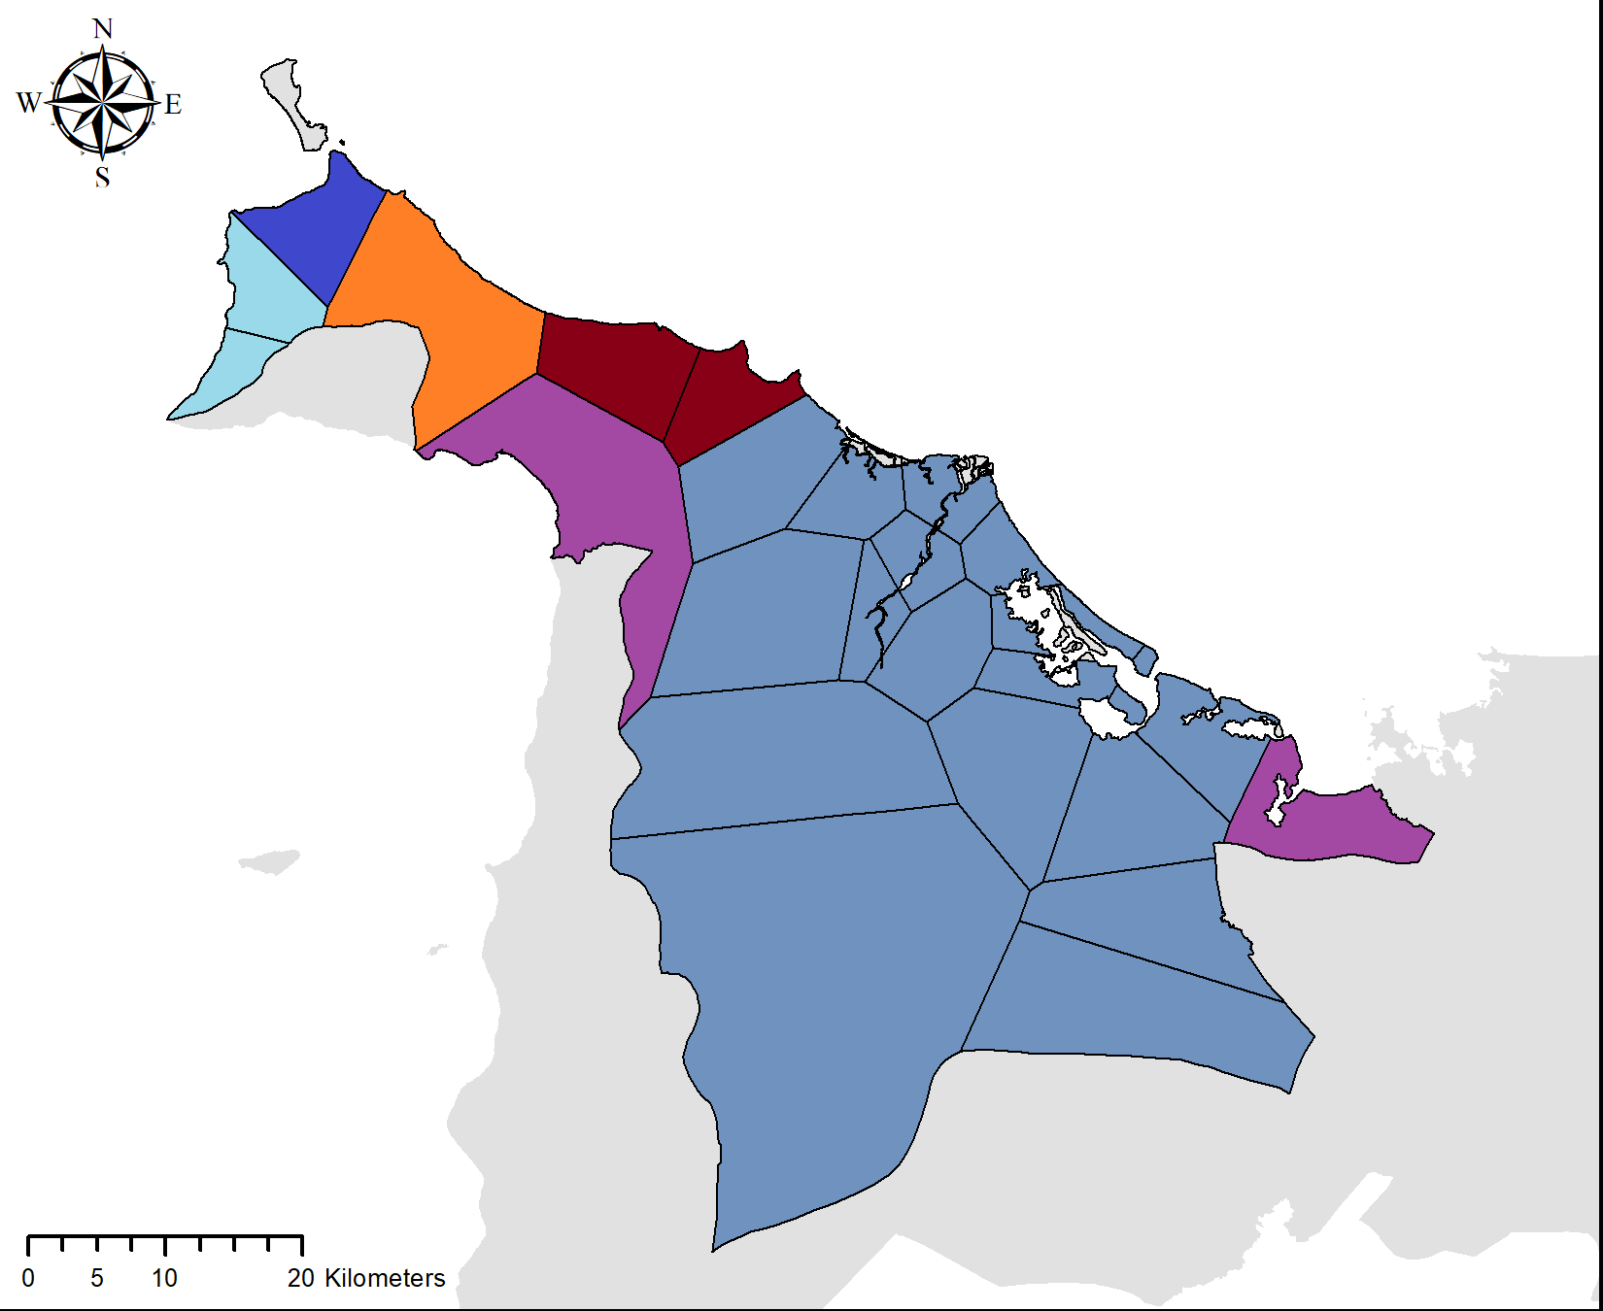
Lexeme map based on Voronoi method
THUNDER
[da'ʔugdɔg]
[da'guʔɔg]
[da'guʔɔb]
[du'ɣugdɔg]
[da'ɣugdɔg]
[da'lugdɔg]

Slide 28
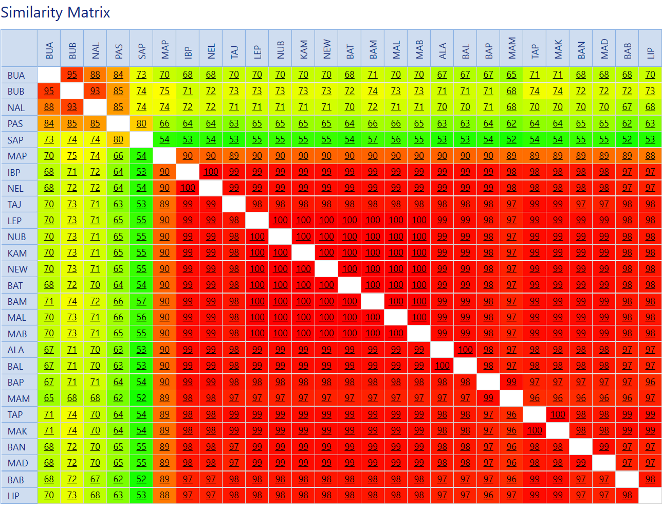
Similarity
matrix

Slide 29
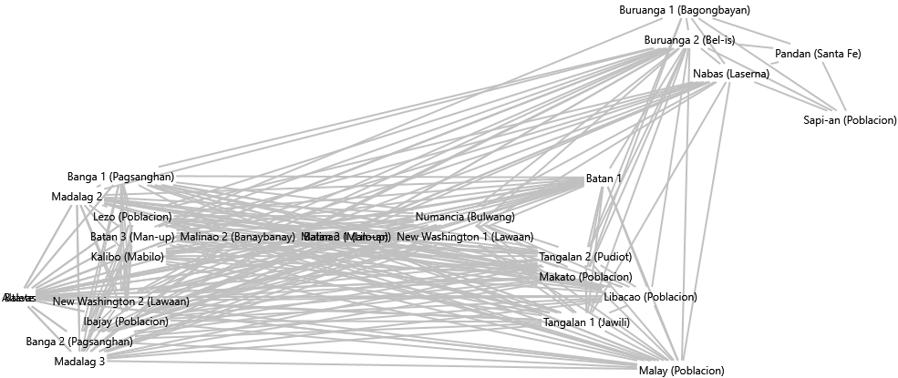
Network graph

Slide 30
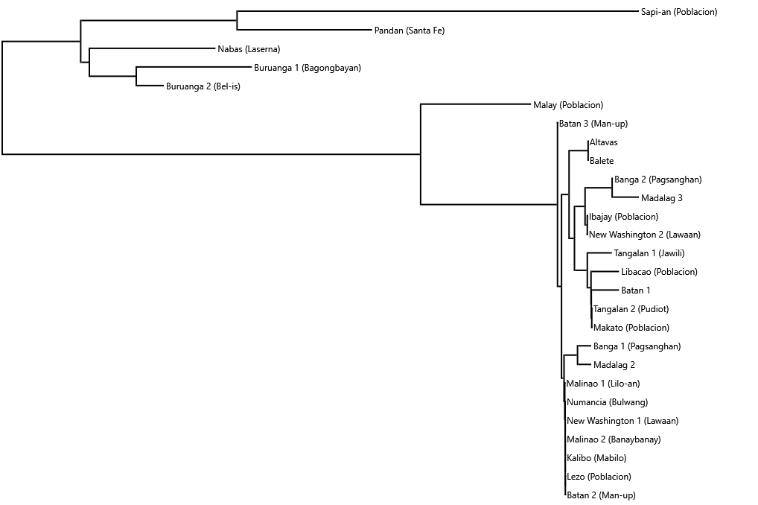
Comparative dendrogram
Neighbor joining method (lexical data)

Slide 31
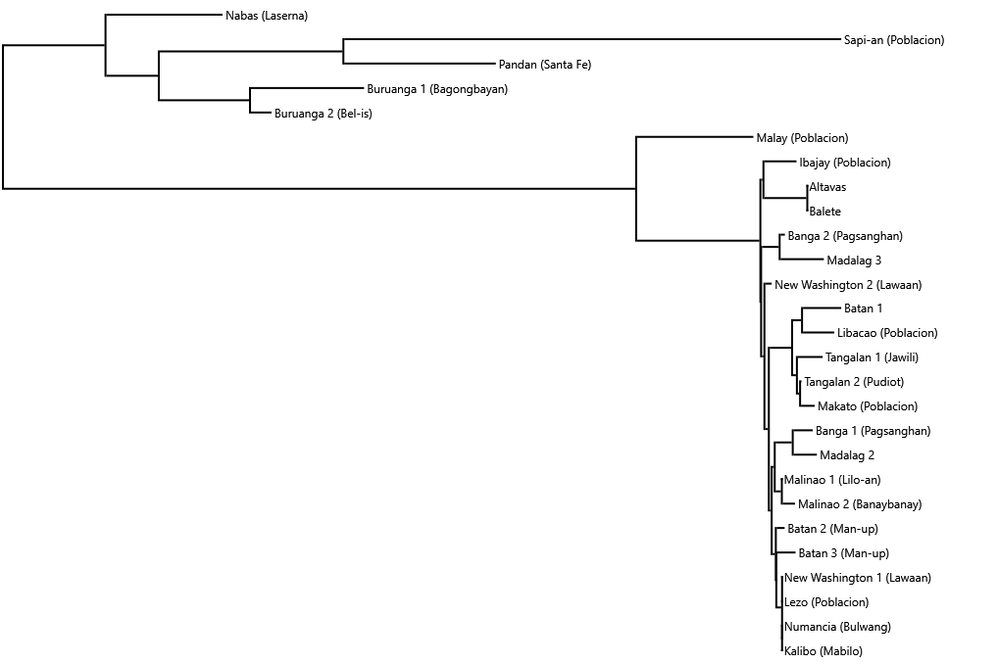
Comparative dendrogram
Neighbor joining method (phonetic data)

Slide 32
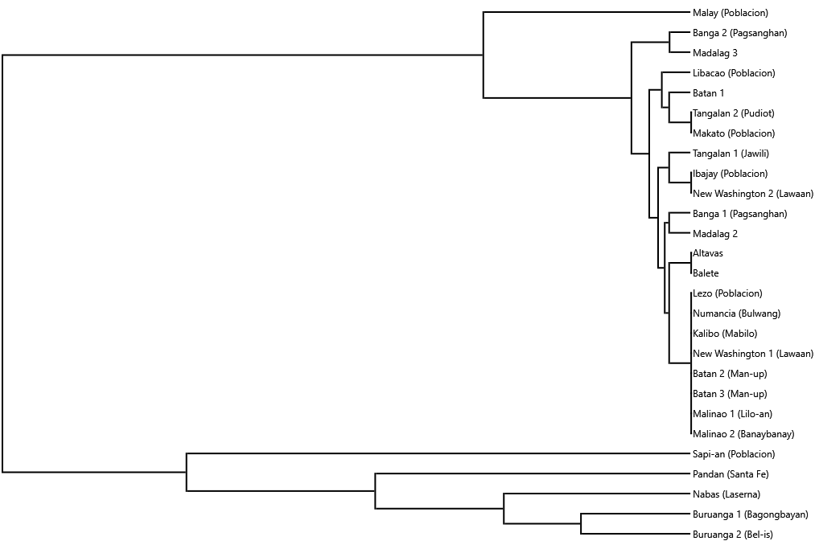
Comparative dendrogram
Unweighted pair group method with arithmetic mean (lexical data)

Slide 33
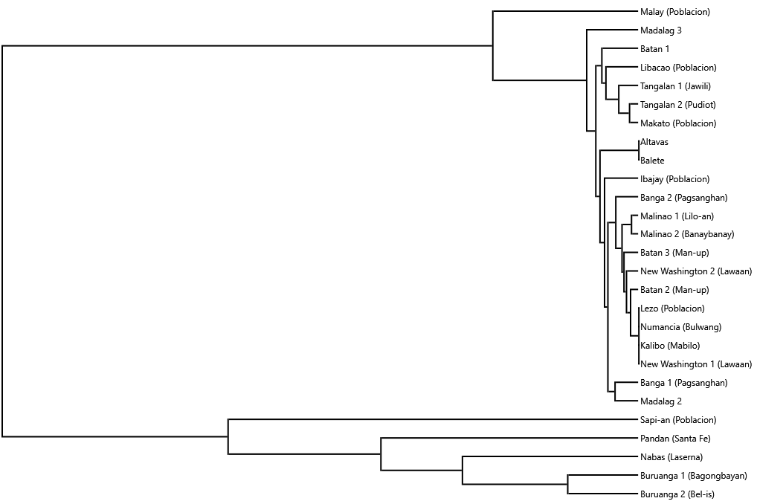
Comparative dendrogram
Unweighted pair group method with arithmetic mean (phonetic data)

Slide 34
Post-processing analysis
Geography and channels of human movement likely as factors in facilitating distribution of features within Aklan
  Clear core group noted in data from towns along Aklan River based on both mapping and clustering analyses
  Consistent clustering of northwestern Aklan towns with tons with extra-core Aklanon features (Kinaray-a? Capiznon?)

Slide 35
Post-processing analysis
Possible language contact effects in certain border towns
Need for finer datasets ideally including representative data from all barangays of each town
Need to expand data across entire mainland Panay (Antique, Capiz, Iloilo) and nearby islands (Caluya group, Romblon group, Guimaras) for effective integration of Philippine topographic contour and longitudinal population datasets in GIS analysis

Slide 36
Maabo gid nga saeamat!
Maabo gid nga saLamat!

